Slide 1
Understanding online risks
Unit: Staying safe and smart online

Slide 2
Objective
I can describe common online risks and explain how to avoid or respond to them.

Slide 3
Keywords
Phishing happens when someone pretends to be a trusted company to trick you into sharing personal information, such as passwords or bank details.
Radicalisation is when people try to influence others online to adopt extreme or harmful beliefs.

Slide 4
Keywords
Online bullying is when someone uses the internet to hurt or upset someone repeatedly, such as by leaving mean comments or sending messages.
Reporting is when you tell a trusted adult or platform about harmful or unsafe behaviour you encounter online.

Slide 5
What do you already know?
You already know how important it is to keep your passwords private and secure.
You understand that not everything you see online is trustworthy and that some websites might spread false information.
You have learned how to stay safe by avoiding sharing personal details with strangers online.
You’ve also practised being kind and respectful when communicating in digital spaces.

Slide 6
Steps to success
Scams and phishing
Radicalisation
Online bullying
Keeping yourself safe

Slide 7
Scams and phishing
What is a scam?
A scam is a trick designed to steal your money, personal information or data.
Why do you think people may fall for scams?
People may fall for scams because scammers often make their messages look very real and trustworthy.
They might pretend to be from a company you know, such as your bank or a delivery service. Scammers also use tricks such as creating a sense of urgency, by saying something bad will happen if you don’t act quickly.

Slide 8
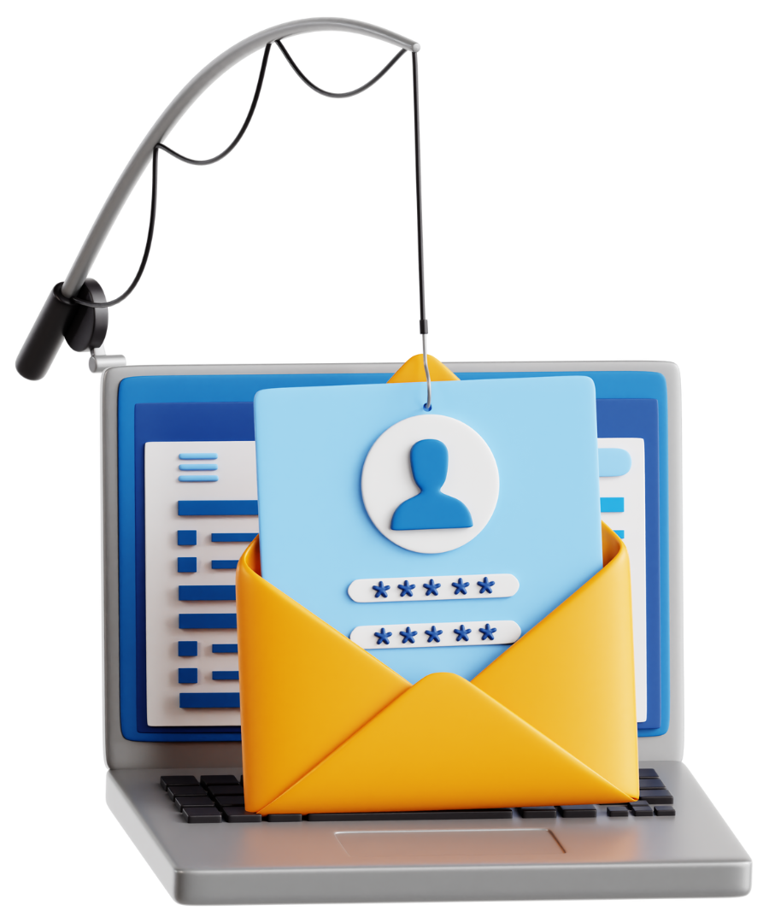
Scams and phishing
Phishing is when someone pretends to be a trusted company or person to trick you into sharing personal information such as passwords, bank details or other sensitive data.
It often happens through emails, messages or fake websites.

Slide 9
Scams and phishing
A scammer sends you an email or message pretending to be from a trusted company (e.g. your bank, a shop or a delivery service).
The email asks you to click a link or download an attachment.
The link takes you to a fake website that looks real, where you’re asked to enter your personal details.
Once you enter your details, the scammer can use them.

Slide 10

Scams and phishing
Important: Your Account Has Been Locked!
To: jbloggs@gmail.com
Today 9:10 AM
From: 2843285401@mybank.com
Dear Customer,
We’ve noticed suspicious activity in your account. To protect your account, we’ve temporarily locked it. Please click the link below to verify your details and unlock your account.
Thank you,
Your Bank
Click here to verify your account

Slide 11
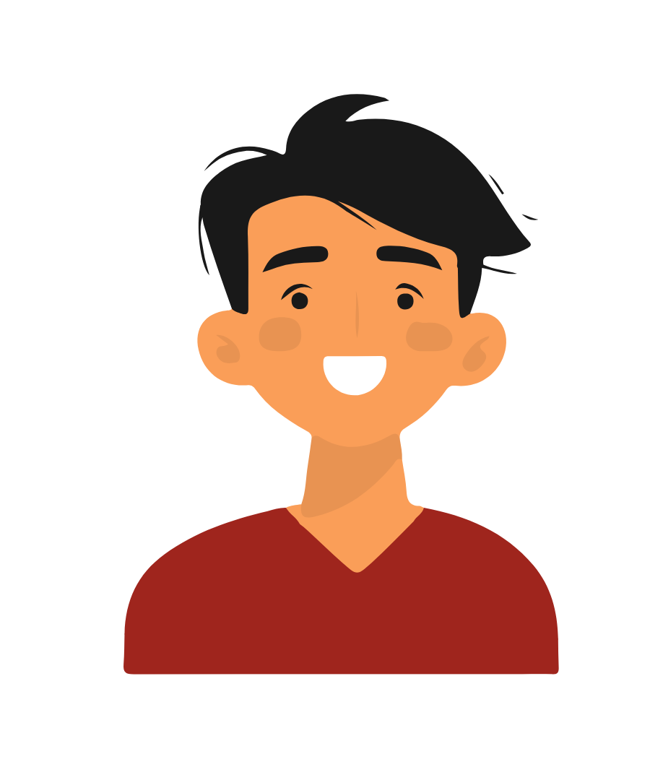

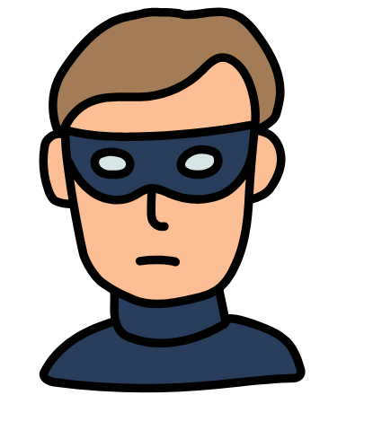

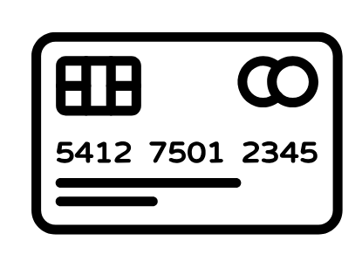
Scams and phishing
The email asks them to click on a link to a fake website pretending to be their bank.
A scammer sends an email to the victim pretending to be from their bank.
The victim clicks on the link. The fake website asks them to enter their bank details to log in.
The victim believes it is from their bank and opens the email.
The details are sent to the scammer who uses them to steal money from the bank account.
The user inputs their bank details.

Slide 12
Scams and phishing
Important: Your Account Has Been Locked!
To: jbloggs@gmail.com
Today 9:10 AM
From: 2843285401@mybank.com
Dear Customer,
We’ve noticed suspicious activity in your account. To protect your account, we’ve temporarily locked it. Please click the link below to verify your details and unlock your account.
Thank you,
Your Bank
Click here to verify your account
The email doesn’t use their name (it says "Dear Customer").

Slide 13
Scams and phishing
Important: Your Account Has Been Locked!
To: jbloggs@gmail.com
Today 9:10 AM
From: 2843285401@mybank.com
It creates panic by saying your account is locked.
Dear Customer,
We’ve noticed suspicious activity in your account. To protect your account, we’ve temporarily locked it. Please click the link below to verify your details and unlock your account.
Thank you,
Your Bank
Click here to verify your account

Slide 14
Scams and phishing
Important: Your Account Has Been Locked!
To: jbloggs@gmail.com
Today 9:10 AM
From: 2843285401@mybank.com
Dear Customer,
We’ve noticed suspicious activity in your account. To protect your account, we’ve temporarily locked it. Please click the link below to verify your details and unlock your account.
Thank you,
Your Bank
Click here to verify your account
The link is suspicious – banks don’t ask for details such as this.

Slide 15
Scams and phishing
Important: Your Account Has Been Locked!
To: jbloggs@gmail.com
Today 9:10 AM
From: 2843285401@mybank.com
Dear Customer,
We’ve noticed suspicious activity in your account. To protect your account, we’ve temporarily locked it. Please click the link below to verify your details and unlock your account.
Thank you,
Your Bank
Click here to verify your account
Don’t click the link.
Go to your bank’s official website or call them directly.

Slide 16
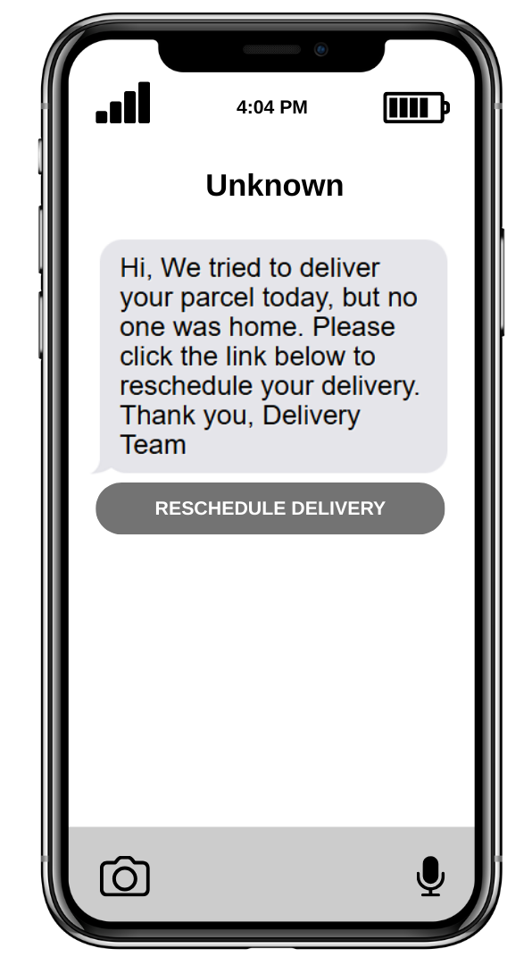
Scams and phishing
There is no mention of which delivery company this is from.
The link could take you to a fake website asking for personal or payment details.
Ignore the message. If you are expecting a parcel, check directly with the delivery company’s official website.

Slide 17
Scams and phishing
How can you spot a phishing scam?
Generic greeting: Emails that say “Dear Customer” instead of using your name.
Urgency: Messages that try to make you panic, such as “Your account will be closed!”
Suspicious links: Links that do not match the company’s official website.

Slide 18
Scams and phishing
There are ways to protect yourself:
Think before you click: Do not click links or download attachments from unknown senders.
Verify the sender: Check the email address – does it look real?
Visit websites directly: Type the company’s website into your browser instead of clicking links.
Report phishing: Tell a trusted adult or report the email to the platform.

Slide 19
1: Scams and phishing
Read the emails carefully: Pay attention to the subject, sender and content of each email.
Your Monthly Subscription Receipt
Your Account Will Be Closed!
To: jbloggs@gmail.com
To: jbloggs@gmail.com
From: support@streamflix.com
08:37 AM
From: support@str3am-flix-security.com
02:13 PM
Hi Joe,
Thank you for your payment. Your StreamFlix subscription has been renewed successfully.
Details of your payment:
Amount: £9.99
Date: 5th May 2025
If you have any questions, feel free to contact us through our official website: www.streamflix.com.
Thank you for being a valued customer!
Best regards,
The StreamFlix Team
Dear Customer,
We have detected suspicious activity in your StreamFlix account. For your safety, we have temporarily locked your account.
To unlock your account, please click the link below and verify your details:
If you do not act within 24 hours, your account will be permanently closed.
Thank you,
StreamFlix Security Team
Click here to verify your account

Slide 20
1: Scams and phishing
Read the emails carefully: Pay attention to the subject, sender and content of each email.
Decide if each email is real or fake:
Do you think both emails are real?
Are both emails fake?
Or is one real and the other fake?
Write down your answer: For each email, write whether you think it’s real or fake.
Explain your reasons:
What made you think the email is real or fake?
Look for clues such as the sender’s email address, who it is addressed to, the tone of the message and the link.
Use evidence from the email to support your answer.

Slide 21
1: Scams and phishing ANSWERS
Email 1 is real because it uses Joe’s name, not just "Dear Customer". The sender’s email address looks professional and matches the company name. The tone is calm and the link matches the official website.
Your Monthly Subscription Receipt
To: jbloggs@gmail.com
From: support@streamflix.com
08:37 AM
Hi Joe,
Thank you for your payment. Your StreamFlix subscription has been renewed successfully.
Details of your payment:
Amount: £9.99
Date: 5th May 2025
If you have any questions, feel free to contact us through our official website: www.streamflix.com.
Thank you for being a valued customer!
Best regards,
The StreamFlix Team

Slide 22
1: Scams and phishing ANSWERS
Email 2 is fake because it uses "Dear Customer" instead of Joe’s name. The sender’s email address looks strange, with "str3am-flix-security.com". It tries to make Joe panic by saying the account will be closed and the link does not look safe.
Your Account Will Be Closed!
To: jbloggs@gmail.com
From: support@str3am-flix-security.com
02:13 PM
Dear Customer,
We have detected suspicious activity in your StreamFlix account. For your safety, we have temporarily locked your account.
To unlock your account, please click the link below and verify your details:
If you do not act within 24 hours, your account will be permanently closed.
Thank you,
StreamFlix Security Team
Click here to verify your account

Slide 23
Steps to success
Scams and phishing
Radicalisation
Online bullying
Keeping yourself safe

Slide 24

Radicalisation
Radicalisation is when someone tries to influence you into adopting extreme or harmful beliefs.

Slide 25
Radicalisation
What do we mean by “extreme views”?
Extreme views are opinions or beliefs that go far beyond what most people consider reasonable, fair or balanced. These views often:
Blame or target certain groups unfairly.
Promote hate, violence or harmful actions.
Reject facts or evidence in favour of false information.
It is important to question extreme views because they can spread fear and anger and may be used to manipulate people.

Slide 26
Radicalisation
How radicalisation happens online:
Pretending to be a friend to gain trust.
Sharing emotional or frightening content to manipulate you.
Using fake facts or edited videos to persuade you.
Inviting you to private groups to share extreme ideas.

Slide 27
Radicalisation
It is important to be aware of radicalisation and take precautions when online:
Ask: "Is this true? Who is sharing it? Why does it make me feel this way?"
Check the source – is it trustworthy?
Talk to a trusted adult if something feels wrong.
Report harmful content online.

Slide 28
Radicalisation
Jamie joined a new gaming group online and started chatting with someone called Alex.
At first, Alex was really friendly and gave Jamie tips on how to improve in the game.
After a few days, Alex started sharing videos that blamed certain groups of people for problems in the world.
Alex also invited Jamie to join a private chat group where people were sharing similar videos and messages. Jamie felt uncomfortable but did not know what to do.

Slide 29
Steps to success
Scams and phishing
Radicalisation
Online bullying
Keeping yourself safe

Slide 30
Online bullying
What is online bullying?
Online bullying is when someone uses the internet to repeatedly hurt or upset someone, such as by sending mean messages or posting nasty comments.

Slide 31
Online bullying
Online bullying can include sending mean messages, posting nasty comments, sharing embarrassing pictures or leaving someone out on purpose in group chats or games.
It can happen on social media, in games or through private messages.

Slide 32
Online bullying
How might someone feel if they are being bullied online?
They might feel sad, lonely, scared or as though they do not want to go online anymore.
Why do you think people bully others online?
Some people bully online because they feel angry, jealous or want to appear powerful.

Slide 33
Online bullying
Online bullying can seriously harm someone’s life.
Emotional Impact:
Makes people feel sad, scared or alone.
It can also lead to anxiety or depression.
Social Impact:
People might avoid friends, school or social activities.
They may feel isolated and lose confidence.

Slide 34
Online bullying
Long-Term Effects:
Hurtful words and posts can stay online forever.
Victims might struggle to trust others or feel safe online.
Online bullying is not harmless – it can deeply hurt someone’s mental health and wellbeing. Always think before you post or comment.

Slide 35
Online bullying
If it is happening to you:
Do not respond: Avoid replying to mean messages or comments – it can make things worse.
Save evidence: Take screenshots of the messages or comments in case you need to report it later.
Block the bully: Use the platform’s settings to block the person who is bullying you.
Tell someone you trust: Speak to a parent, teacher or another trusted adult about what is happening.
Report it: Use the "report" feature on the app or website to let the platform know about the bullying.

Slide 36
Online bullying
If you see someone else being bullied:
Do not join in: Avoid liking or sharing hurtful messages or posts.
Support the victim: Send them a kind message or let them know you are there for them.
Report the bullying: Use the platform’s tools to report the behaviour, even if it is not happening to you.
Tell an adult: Speak to a teacher, parent or another trusted adult so they can help.

Slide 37
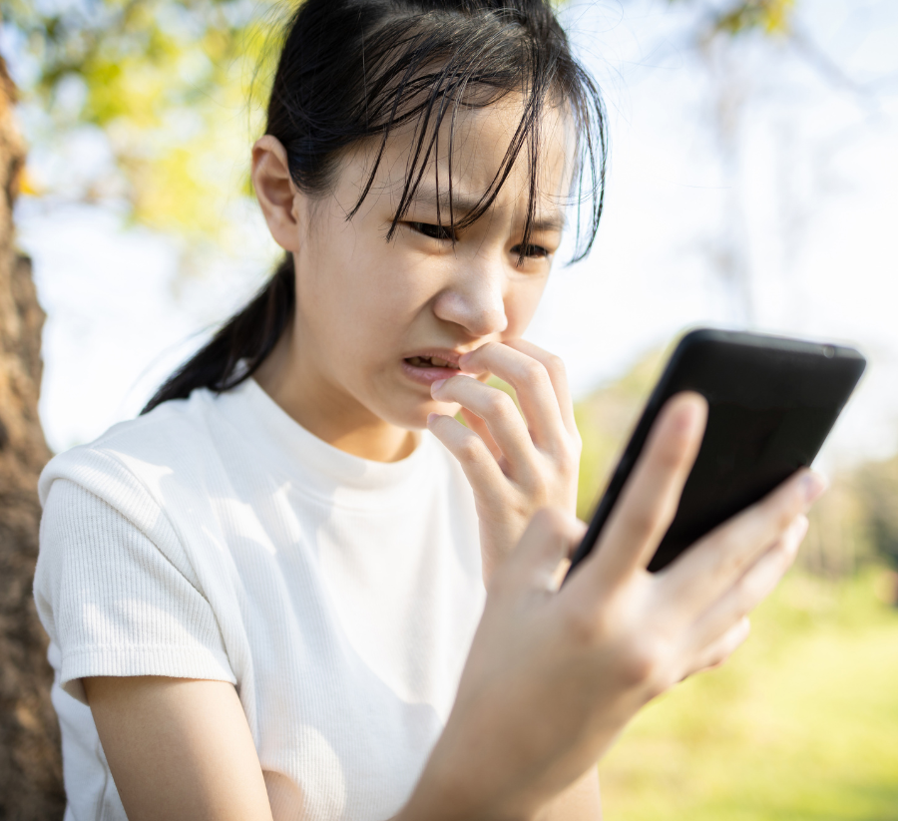
Online bullying
Online bullying can hurt people deeply, but by taking action and supporting each other, we can make the internet a safer and kinder place.

Slide 38
Steps to success
Scams and phishing
Radicalisation
Online bullying
Keeping yourself safe

Slide 39
Keeping yourself safe
Most platforms (social media, games) have a “Report” button.
Use it to report harmful messages, comments or profiles.
Follow the steps provided by the platform to explain the issue.
Reporting and telling a trusted adult helps to keep you and others safe online.

Slide 40
Keeping yourself safe
It is important to tell a trusted adult because they can support you and help take further action if needed.
Adults can contact schools, platforms or even the police if the situation is serious.
Speaking up ensures the harmful behaviour is stopped and others are protected.

Slide 41
Keeping yourself safe
You receive an email from “Your Bank” saying, “We’ve noticed unusual activity on your account. Click here to verify your details.”
What type of risk is this?
This is a phishing scam designed to steal your personal or financial information.
What should you do if you receive this email?
Do not click the link or reply to the email. Contact your bank directly using their official website or phone number to check if there is an issue.

Slide 42
Keeping yourself safe
Someone sends you a message in a game saying, “Click this link to get free rewards!” The link looks suspicious.
What type of risk is this?
This could be a scam designed to trick you into downloading harmful software or sharing personal information.
What should you do if you receive this message?
Ignore and delete the message. Do not click on the link.

Slide 43
Keeping yourself safe
A classmate creates a group chat and starts sharing mean jokes about another pupil. They encourage others to join in.
What type of risk is this?
This is online bullying, which can harm someone emotionally and socially.
What should you do if you see this behaviour?
Do not participate in the bullying, take sreenshots as evidence of the bullying in case you need them later. Leave the group chat and report it to a trusted adult or teacher.

Slide 44
Keeping yourself safe
A stranger sends you a friend request on social media and starts asking you personal questions, such as where you live or what school you go to.
What type of risk is this?
This is a potential grooming or identity theft risk, as the stranger could misuse your personal information.
What should you do if you see this behaviour?
Do not reply to the messages. Block the person and report their account to the platform.

Slide 45
Keeping yourself safe
You see a video online that blames a specific group of people for problems in the world and encourages viewers to take action against them.
What type of risk is this?
This is an example of radicalisation or spreading extreme views, which can influence people to adopt harmful beliefs.
What should you do if you see this video?
Do not share or engage with the video. Report it to the platform and tell a trusted adult about it.

Slide 46
Summary of lesson
Today, we learned about staying safe online by recognising risks such as scams, bullying and extreme content.
We explored how to respond to these situations, such as reporting harmful behaviour and telling a trusted adult.
By understanding these dangers, we can protect ourselves and others while using the internet responsibly.
You developed important skills such as critical thinking, teamwork and being safe and responsible online.

Slide 47
© 2025 Nichola Wilkin Ltd
https://www.nicholawilkin.com/terms

